Slide 1
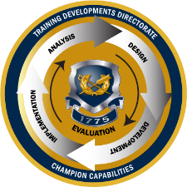
TJAGLCS Training Package
Advising Commanders
December 2024

Slide 2
The information provided throughout this training aid does not, and is not intended to, constitute legal advice; instead, all information, laws, statues, content, and materials for this training aid are for general informational purposes only. This training aid may not constitute the most up-to-date legal or other relevant legal information. Judge Advocates need to conduct their own due diligence through independent further legal research on any specific legal issue contained in this training package. No reader, user, or trainee of this product should act or refrain from acting based on information from this training aid without first seeking legal advice from an attorney in the relevant jurisdiction.

Slide 3
Advising Commanders

Slide 4
Learning Objectives
Describe the duties of a legal advisor in the military justice system and required skills necessary to build trust with the command.
Understand the commander’s role and strategic responsibility.
Discuss the art of command advice.
Recognize who is your client and identify danger areas for legal advisors.
Discuss the importance of providing accurate and timely legal advice.

Slide 5
Objective 1: Relationship between a commander and the legal advisor in the military justice system
FOCUS: How to build trust?

Slide 6
How to Build Trust?
Rapport building
Physical fitness
Military bearing
Active listening
Timeliness
Prepare for your meetings
Have a paper and pen
Briefing materials?
Research/collaboration
Answer your phone and e-mails
Email etiquette
Sir/Ma’am
If you’re unable to provide an answer at least acknowledge receipt
Be a team player/staff integration
Don’t talk down to commanders
Avoid legalese and get to the point quickly “BLUF”
Goal: Become a trusted legal professional
Notes:
https://mwi.westpoint.edu/staff-officers-paintbrush-art-advising-commanders/

Slide 7
Objective 2: Understand the role of the legal advisor
FOCUS: What is your role in the process?

Slide 8
Trial Counsel Responsibilities
Command Advice
Court-martial Duties
Advise CDRS/1SG
Advise BN CDRS/CSMs
Litigate
Assist with investigation strategies
Advise law enforcement (CID/MPI)
NJP
Boards
Separations
Prepare charges
Litigate motions
Try guilty pleas
Try contested cases
Assist OSTC
Notes:
https://mwi.westpoint.edu/staff-officers-paintbrush-art-advising-commanders/

Slide 9
Practice Tips
Know your Value to the organization
Never shoot from the hip!
You provide advice, commanders make decisions!!!!!
Highlight any legal constraints of commander’s authority
OSTC jurisdiction for covered, known or related offenses
Law
Know your Role in the process
Get to Yes?
Options? “Can, Must, Should, Will Not.”
Personal Courage
Radical Candor
Credibility
Notes:
Building Trust expands your scope of advice, perhaps beyond the purely legal.

Slide 10
Objective 3: the art of command advice
Focus: Understanding the Commander’s intent

Slide 11
What Do You Expect From Your Judge Advocate?
“You’re not the commander, you don’t get to say yes or no but you do get to say this is legally objectionable”
“Give me options and get me to a yes if possible”
“Keep me away from the gray zone”
“When making non-legal recommendations make sure you’re identifying them and saying this is a non-legal one”
“Be an operational lawyer”
“Be predictive and provide risk at multiple echelons and potential outcomes if the risk is underwritten by the commander”
Notes:
These responses were collected from current and past commanders.

Slide 12
Knowing Your Client
Initial Counseling
Three C’s of Information
Clear
Concise
Comprehensive
Respect your Commander’s Rank and Authority
What are the commander’s priorities and judicial philosophy?
Know when to Provide Perspective and when to Gain Perspective
Notes:
Who is your client commander or the Army?

Slide 13
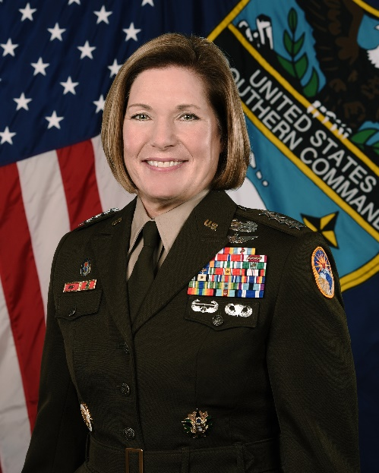
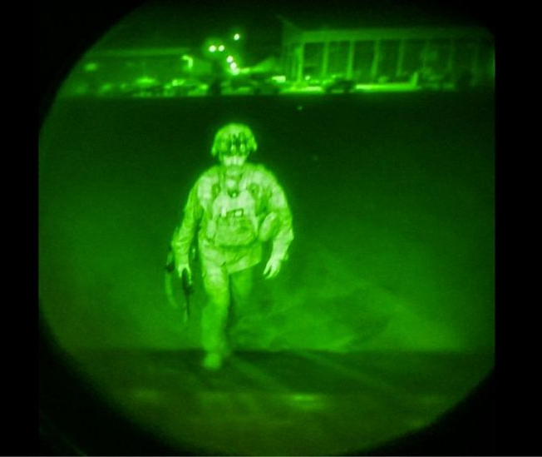
Commander’s Role
Play a quasi-judicial role
Establish standards and policies
good order and discipline
Decision maker
Training/Readiness
Justice
Fairness
Strategic planning
Conducting LSCO

Slide 14
Command Decision Points
Report an Offense
Assist the victim
SAIRO, CCIR, other reports or notifications to higher
Restriction or confinement
Investigation
Inquiry (R.C.M. 303) or Investigation (AR 15-6)
Disposition
-Prefer charges
-NJP
-Admin Action (GOMOR/Board)
-No Action
Disposition Considerations
Severity of the crime
Weight of the evidence
Victim
Good order and discipline
Timeliness
Avoid UCI
Notes:
Practice tip: Get CID to tell you is not in your purview

Slide 15
Crafting Legal Advice
Low risk
Medium risk
High
risk
Ma’am: “If you decide to take X action there is a low risk of X because Y. I highly recommend you do Z.”
Notes:
It is very important for JAs to understand how to provide the legal advice and their role in the process.
Commanders-make decisions
JAs- provide advice, recommendations, courses of action and inform the commander in terms of risks.

Slide 16
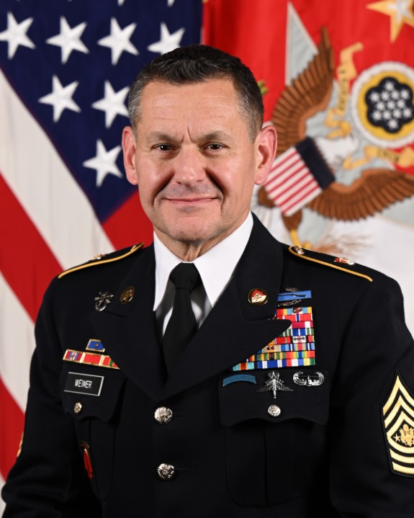
Senior Enlisted Advisor
Respect your Commander’s and their senior enlisted advisor’s experience
Non-lawyer, but more experienced
Critical thinker & problem solver

Slide 17
Vignette #1
Advising a Superior
Providing Perspective
You are the TC for the Commander, 1st BCT, 101st Airborne Division. The CG has a local policy that withholds all senior leader misconduct, MSG and above, to his level. The CG has a separate policy that requires Judge Advocates to send a 5Ws email through their technical chain for ALL senior leader. misconduct. A decorated MSG in 1st BCT was accused of failing to provide spousal support by his estranged spouse.
The 1st BCT Commander does not want to notify the CG of the alleged misconduct until he knows more about the allegation and prefers to handle the case AT HIS LEVEL.
Understand staff officer role and military culture
Bad: “You can’t do that.”
Better: “Sir/Ma’am, I recommend that you do x because of y.”

Slide 18
Vignette #2
Learn from Commander’s Experience
Gain Perspective
You are the TC for a Commander forward deployed. One of the Commander’s Soldiers, a Sergeant First Class (E-7) was recently investigated for Basic Allowance for Housing (BAH) fraud totaling $10,000. The case is substantiated by CID, and you recommend that the commander prefer charges at court-martial.
The Commander, decides to issue a Field Grade Article 15 for the offense, but takes no further action.
What are your thoughts on this punishment? Not severe enough? Appropriate?
What should you understand about your commander’s experience with DFAS accounting?
Opportunity to GAIN PERSPECTIVE.
5Ws. Don’t overpromise and underperform.

Slide 19
Vignette #3
Know Your Commander’s Priorities
Tailoring Advice
You are the TC for the Sustainment Brigade, 82d Airborne Division. One of the riggers tests positive for marijuana on the last urinalysis and the Division has a major exercise coming up involving airborne operations. The Paratrooper is a 20-year-old Specialist with no prior disciplinary problems and by all accounts is a fantastic Paratrooper.
The Battalion Commander issues a FG15 to the Specialist and finds him guilty. The Soldier is sentenced to reduction to PVT (E1), forfeiture of ½ months pay for 2 months, 45 days extra duty, and 45 days restriction.
What are your thoughts on this punishment? Harsh? Appropriate?
Notes:
What are you thoughts on this punishment? Harsh? Appropriate?
What should you understand about the commander’s priorities and mission before rendering advice?
What impact is there on the mission?

Slide 20
Danger Areas
Answering without research
Failing to provide prompt advice
Confidentiality
OSTC covered offenses
Who else needs to know? Top-cover?
Saying “no” without providing options!
Remember: commanders make decisions, and legal advisors provide recommendations and advice in terms of risk.
What if commander disagrees with your opinion?

Slide 21
Questions?

Slide 22
Need Training Materials?
Have Training Materials?
Questions?
Contact Us!
TJAGLCS-training@army.mil

